Slide 1

Introduction to Probabilistic Machine Learning
Ralf Herbrich
Factor Graphs

Slide 2
Overview
Probabilistic Machine Learning
The Sum-Product Algorithm
Ranking Problems
TrueSkill

Slide 3
Overview
Probabilistic Machine Learning
The Sum-Product Algorithm
Ranking Problems
TrueSkill

Slide 4
Probabilistic Machine Learning: Terminology
Given:
Training Data: $D∈{\left(𝒳×𝒴\right)}^{n}$ of $n$ (labelled) examples from the input space $𝒳$ and output space $𝒴$
Binary Classification: $𝒴=\left\{0,1\right\}$
Regression: $𝒴=ℝ$
Prior belief over functions from $𝓧$ to $𝓨$: $p\left(f\right), f∈ℱ$
Space of functions, $ℱ$, is also called hypothesis space.
Likelihood of function: $p\left(D | f\right)=:ℓ\left(f\right)$
Link between data and functions
Normalizes over $D$ but not over $f$ – never say “likelihood of data”!
Models all assumptions how data/labels are generated from a function
Key Questions in Machine Learning:
Prediction: What is $p\left(y|x,D\right)$for an example $x$ and having seen $D$?
Decision Making: What prediction $\hat{y}$ shall be made for an example $x$ having seen $D$?

Slide 5
Probabilistic Machine Learning: Polynomial Regression
Likelihood
$$ℓ \left(w\right)=\prod_{i}{𝒩\left(y_{i};w_{1}x_{i}+w_{2}x_{i}^{2},σ^{2}\right)}$$
Training Data
$$D∈ℝ^{2}$$
Prior
$$p\left(w\right)=𝒩\left(w_{1};0,1\right)⋅𝒩\left(w_{2};0,1\right)$$
$$f\left(x;w\right)=w_{1}⋅x+w_{2}⋅x^{2}$$

Slide 6
Predictions and Predictive Distributions
$$P\left(y|x,f\right)$$
Predictive distribution using the sum rule of probability
$$p\left(y|x,D\right)=∫p\left(y|x,f\right)⋅p\left(f|D\right) df$$
But how do we get $p\left(f | D\right)$? Bayes’ rule!
$$p\left(f | D\right)=\frac{p\left(D|f\right)⋅p\left(f\right)}{p\left(D\right)}$$
$$P\left(f|D\right)$$
$$P\left(D|f\right)$$
$$P\left(f\right)$$

Slide 7
Probabilistic Machine Learning: Bayesian Inference
Two computational difficulties:
Posterior $p\left(f | D\right)$ requires the multiplication of likelihood with prior which often results in a distribution which is no longer in a family with very few parameters.
Predictive distribution $p\left(y | x,D\right)$ requires the summation of the data distribution over all prediction functions. This is only feasible for a small number of parametric distributions.
$$p\left(f | D\right)=\frac{p\left(D|f\right)⋅p\left(f\right)}{p\left(D\right)}$$
$$∝ℓ\left(f\right)⋅p\left(f\right)$$
$$p\left(y|x,D\right)=∫p\left(y|x,f\right)⋅p\left(f|D\right) df$$

Slide 8



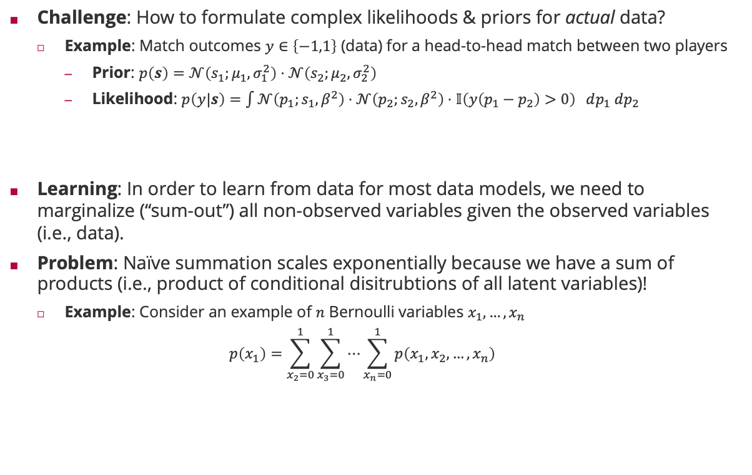



Graphical Models
Challenge: How to formulate complex likelihoods & priors for actual data?
Example: Match outcomes $y∈\left\{−1,1\right\}$ (data) for a head-to-head match between two players
Prior: $p\left(s\right)=𝒩\left(s_{1};μ_{1},σ_{1}^{2}\right)⋅𝒩\left(s_{2};μ_{2},σ_{2}^{2}\right)$
Likelihood: $p\left(y|s\right)=\int{𝒩\left(p_{1};s_{1},β^{2}\right)⋅𝒩\left(p_{2};s_{2},β^{2}\right)⋅𝕀\left(y\left(p_{1}−p_{2}\right)>0\right) dp_{1} dp_{2}}$
Learning: In order to learn from data for most data models, we need to marginalize (“sum-out”) all non-observed variables given the observed variables (i.e., data).
Problem: Naïve summation scales exponentially because we have a sum of products (i.e., product of conditional disitrubtions of all latent variables)!
Example: Consider an example of $n$ Bernoulli variables $x_{1},…,x_{n}$
$$p\left(x_{1}\right)=\sum_{x_{2}=0}^{1}{\sum_{x_{3}=0}^{1}{⋯\sum_{x_{n}=0}^{1}{p\left(x_{1},x_{2},…,x_{n}\right)}}}$$
$$s_{1}$$
$$s_{2}$$
skill belief
$$p_{1}$$
$$p_{2}$$
marginalization
$$y$$
Match outcome
Player performance
$2^{n−1}$ summations

Slide 9
Overview
Probabilistic Machine Learning
The Sum-Product Algorithm
Ranking Problems
TrueSkill

Slide 10



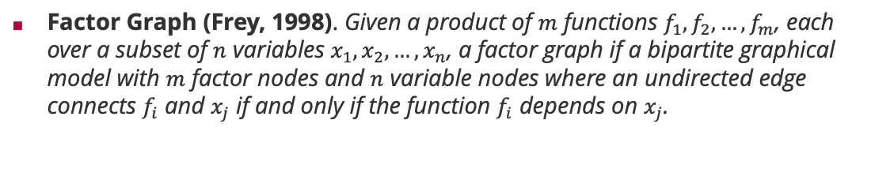






Factor Graphs
Factor Graph (Frey, 1998). Given a product of $m$ functions $f_{1},f_{2},…,f_{m}$, each over a subset of $n$ variables $x_{1},x_{2},…,x_{n}$, a factor graph if a bipartite graphical model with $m$ factor nodes and $n$ variable nodes where an undirected edge connects $f_{i}$ and $x_{j}$ if and only if the function $f_{i}$ depends on $x_{j}$.
Brendan Frey (1968 – )
Bayesian network
Corresponding factor graph
$$x_{1}$$
$$x_{2}$$
$$x_{1}$$
$$x_{2}$$
$$x_{3}$$
$$x_{3}$$
$$p\left(x_{1},x_{2},x_{3}\right)=p\left(x_{1}\right)⋅p\left(x_{2}\right)⋅p\left(x_{3}|x_{1},x_{2}\right)$$
$$p\left(x_{1},x_{2},x_{3}\right)=f_{1}\left(x_{1}\right)⋅f_{2}\left(x_{2}\right)⋅f_{3}\left(x_{3},x_{1},x_{2}\right)$$

Slide 11





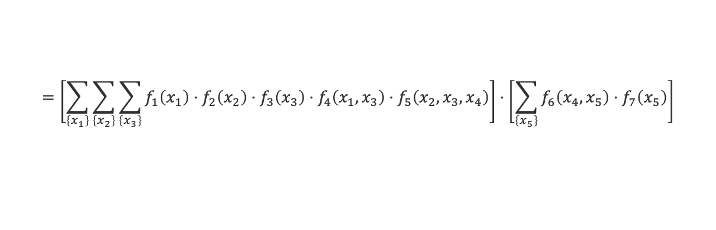



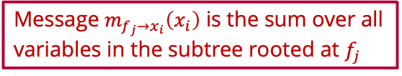









Sum-Product Algorithm: Marginals
$$f_{3}$$
$$f_{1}$$
$$f_{4}$$
$$x_{3}$$
$$x_{1}$$
$$f_{5}$$
$$f_{6}$$
$$f_{7}$$
$$x_{4}$$
$$x_{5}$$
$$f_{2}$$
$$m_{f_{5}→x_{4}}\left(x_{4}\right)$$
$$m_{f_{6}→x_{4}}\left(x_{4}\right)$$
$$x_{2}$$
Message $m_{f_{j}→x_{i}}\left(x_{i}\right)$ is the sum over all variables in the subtree rooted at $f_{j}$
$$p\left(x_{4}\right)=\sum_{\left\{x_{1}\right\}}{\sum_{\left\{x_{2}\right\}}{\sum_{\left\{x_{3}\right\}}{\sum_{\left\{x_{5}\right\}}{f_{1}\left(x_{1}\right)⋅f_{2}\left(x_{2}\right)⋅f_{3}\left(x_{3}\right)⋅f_{4}\left(x_{1},x_{3}\right)⋅f_{5}\left(x_{2},x_{3},x_{4}\right)⋅f_{6}\left(x_{4},x_{5}\right)⋅f_{7}\left(x_{5}\right)}}}}$$
$$=\left[\sum_{\left\{x_{1}\right\}}{\sum_{\left\{x_{2}\right\}}{\sum_{\left\{x_{3}\right\}}{f_{1}\left(x_{1}\right)⋅f_{2}\left(x_{2}\right)⋅f_{3}\left(x_{3}\right)⋅f_{4}\left(x_{1},x_{3}\right)⋅f_{5}\left(x_{2},x_{3},x_{4}\right)}}}\right]⋅\left[\sum_{\left\{x_{5}\right\}}{f_{6}\left(x_{4},x_{5}\right)⋅f_{7}\left(x_{5}\right)}\right]$$
$$m_{f_{5}→x_{4}}\left(x_{4}\right)$$
$$m_{f_{6}→x_{4}}\left(x_{4}\right)$$
Marginals are the product of all incoming messages from neighbouring factors!

Slide 12

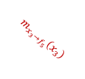
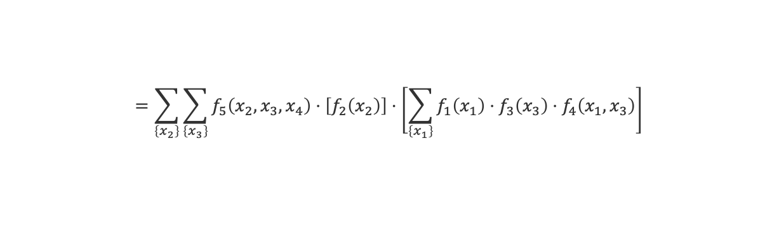

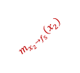





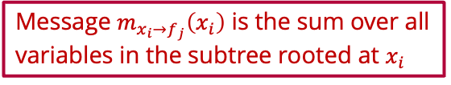
Sum-Product Algorithm: Message from Factor to Variable
$$f_{3}$$
$$f_{1}$$
$$f_{4}$$
$$x_{3}$$
$$m_{x_{3}→f_{5}}\left(x_{3}\right)$$
$$x_{1}$$
$$f_{5}$$
$$f_{6}$$
$$f_{7}$$
$$x_{4}$$
$$x_{5}$$
$$f_{2}$$
$$m_{f_{5}→x_{4}}\left(x_{4}\right)$$
$$m_{f_{6}→x_{4}}\left(x_{4}\right)$$
$$x_{2}$$
$$m_{x_{2}→f_{5}}\left(x_{2}\right)$$
Message $m_{x_{i}→f_{j}}\left(x_{i}\right)$ is the sum over all variables in the subtree rooted at $x_{i}$
$$m_{f_{5}→x_{4}}\left(x_{4}\right)=\sum_{\left\{x_{1}\right\}}{\sum_{\left\{x_{2}\right\}}{\sum_{\left\{x_{3}\right\}}{f_{1}\left(x_{1}\right)⋅f_{2}\left(x_{2}\right)⋅f_{3}\left(x_{3}\right)⋅f_{4}\left(x_{1},x_{3}\right)⋅f_{5}\left(x_{2},x_{3},x_{4}\right)}}}$$
$$=\sum_{\left\{x_{2}\right\}}{\sum_{\left\{x_{3}\right\}}{f_{5}\left(x_{2},x_{3},x_{4}\right)⋅\left[f_{2}\left(x_{2}\right)\right]⋅\left[\sum_{\left\{x_{1}\right\}}{f_{1}\left(x_{1}\right)⋅f_{3}\left(x_{3}\right)⋅f_{4}\left(x_{1},x_{3}\right)}\right]}}$$
$$m_{x_{2}→f_{5}}\left(x_{2}\right)$$
$$m_{x_{3}→f_{5}}\left(x_{3}\right)$$
Messages from a factor to a variable sum out all neighboring variables weighted by their incoming message

Slide 13




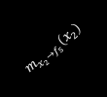






Sum-Product Algorithm: Message from Variable to Factor
$$f_{3}$$
$$m_{f_{3}→x_{3}}\left(x_{3}\right)$$
$$f_{1}$$
$$f_{4}$$
$$x_{3}$$
$$m_{x_{3}→f_{5}}\left(x_{3}\right)$$
$$x_{1}$$
$$f_{5}$$
$$f_{6}$$
$$f_{7}$$
$$m_{f_{4}→x_{3}}\left(x_{3}\right)$$
$$x_{4}$$
$$x_{5}$$
$$f_{2}$$
$$m_{f_{5}→x_{4}}\left(x_{4}\right)$$
$$m_{f_{6}→x_{4}}\left(x_{4}\right)$$
$$x_{2}$$
$$m_{x_{2}→f_{5}}\left(x_{2}\right)$$
$$m_{x_{3}→f_{5}}\left(x_{3}\right)=\sum_{\left\{x_{1}\right\}}{f_{1}\left(x_{1}\right)⋅f_{3}\left(x_{3}\right)⋅f_{4}\left(x_{1},x_{3}\right)}$$
$$=\left[f_{3}\left(x_{3}\right)\right]⋅\left[\sum_{\left\{x_{1}\right\}}{f_{1}\left(x_{1}\right)⋅f_{4}\left(x_{1},x_{3}\right)}\right]$$
$$m_{f_{3}→x_{3}}\left(x_{3}\right)$$
$$m_{f_{4}→x_{3}}\left(x_{3}\right)$$
Messages from a variable to a factor multiply incoming message from neighboring factors

Slide 14

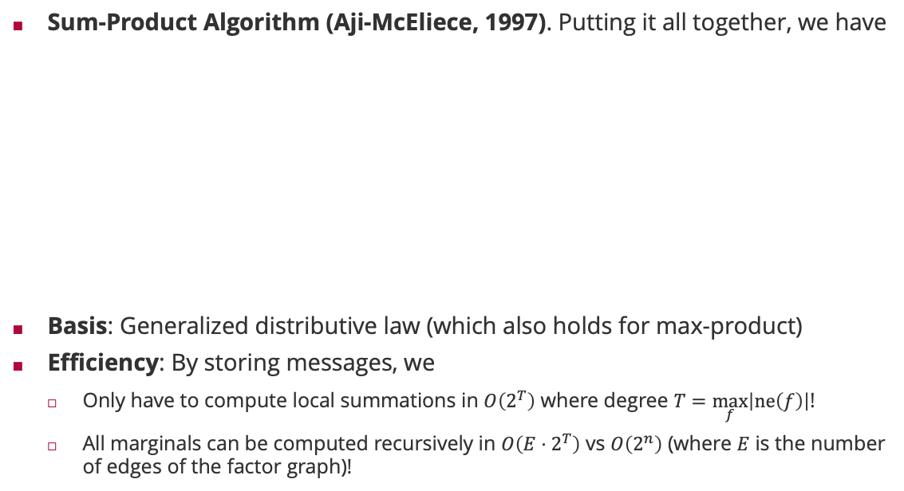
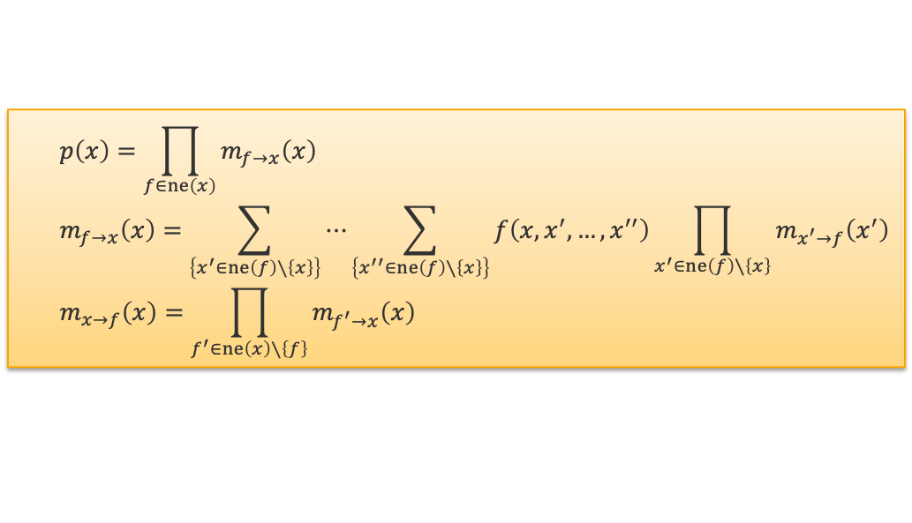
Sum-Product Algorithm
Sum-Product Algorithm (Aji-McEliece, 1997). Putting it all together, we have
Basis: Generalized distributive law (which also holds for max-product)
Efficiency: By storing messages, we
Only have to compute local summations in $O\left(2^{T}\right)$ where degree $T=\max_{f}\left|ne\left(f\right)\right|$!
All marginals can be computed recursively in $O\left(E⋅2^{T}\right)$ vs $O\left(2^{n}\right)$ (where $E$ is the number of edges of the factor graph)!
$$p\left(x\right)=\prod_{f∈ne\left(x\right)}{m_{f→x}\left(x\right)}$$
$$m_{f→x}\left(x\right)=\sum_{\left\{x^{′}∈ne\left(f\right)∖\left\{x\right\}\right\}}{⋯\sum_{\left\{x^{′′}∈ne\left(f\right)∖\left\{x\right\}\right\}}{f\left(x,x^{′},…,x^{′′}\right)\prod_{x^{′}∈ne\left(f\right)∖\left\{x\right\}}{m_{x^{′}→f}\left(x^{′}\right)}}}$$
$$m_{x→f}\left(x\right)=\prod_{f^{′}∈ne\left(x\right)∖\left\{f\right\}}{m_{f^{′}→x}\left(x\right)}$$
Robert McEliece (1942 – 2019)

Slide 15

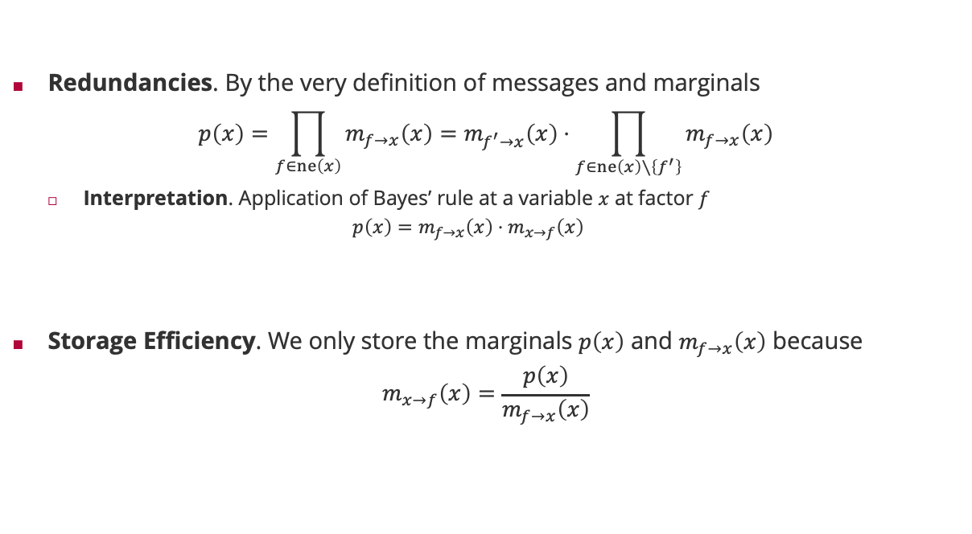

Even more efficiency
Redundancies. By the very definition of messages and marginals
$$p\left(x\right)=\prod_{f∈ne\left(x\right)}{m_{f→x}\left(x\right)}=m_{f^{′}→x}\left(x\right)⋅\prod_{f∈ne\left(x\right)∖\left\{f^{′}\right\}}{m_{f→x}\left(x\right)}$$
Interpretation. Application of Bayes’ rule at a variable $x$ at factor $f$
$$p\left(x\right)=m_{f→x}\left(x\right)⋅m_{x→f}\left(x\right)$$
Storage Efficiency. We only store the marginals $p\left(x\right)$ and $m_{f→x}\left(x\right)$ because
$$m_{x→f}\left(x\right)=\frac{p\left(x\right)}{m_{f→x}\left(x\right)}$$
$$m_{x→f^{′}}\left(x\right)$$
posterior
Likelihood $×$ normalization
prior

Slide 16
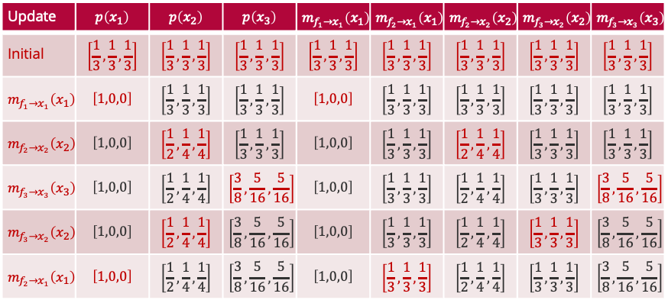
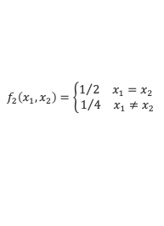

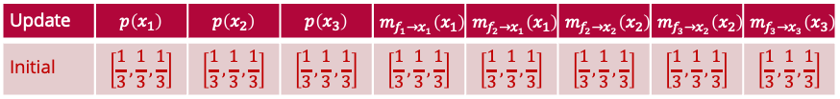
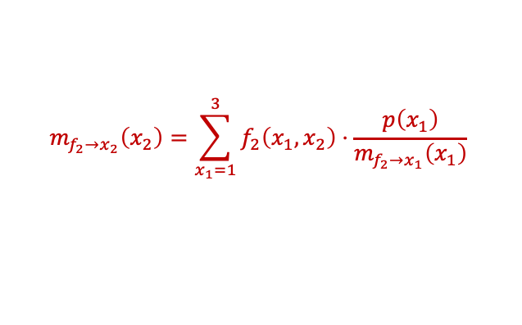
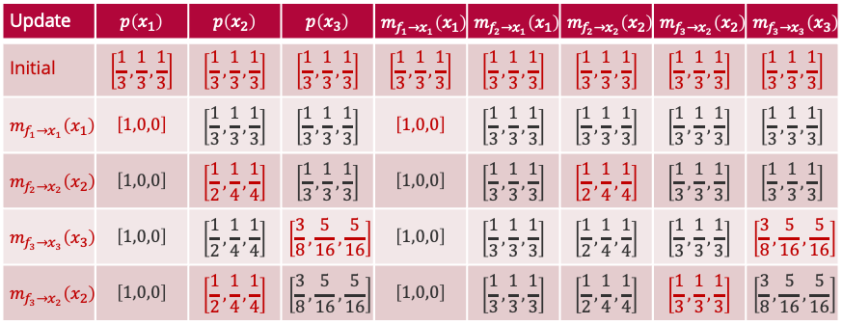


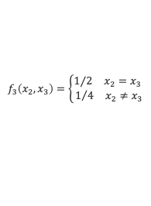

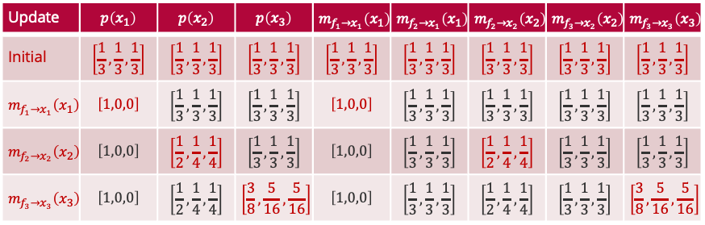

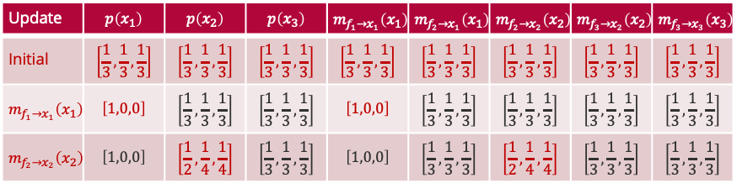



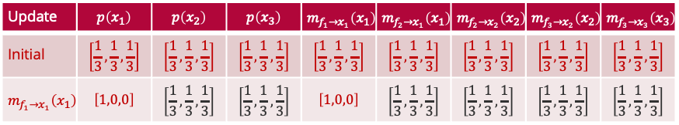
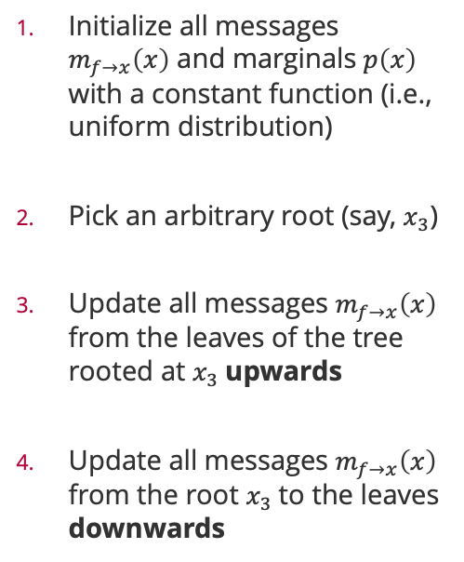


A Practical Implementation
Initialize all messages $m_{f→x}\left(x\right)$ and marginals $p\left(x\right)$ with a constant function (i.e., uniform distribution)
Pick an arbitrary root (say, $x_{3}$)
Update all messages $m_{f→x}\left(x\right)$ from the leaves of the tree rooted at $x_{3}$upwards
Update all messages $m_{f→x}\left(x\right)$ from the root $x_{3}$to the leaves downwards
$$f_{1}\left(x_{1}\right)=𝕀\left(x_{1}=1\right)$$
$$f_{2}\left(x_{1},x_{2}\right)=\left\{\begin{aligned}1/2 x_{1}=x_{2} \\ 1/4 x_{1}≠x_{2}\end{aligned}\right.$$
$$f_{3}\left(x_{2},x_{3}\right)=\left\{\begin{aligned}1/2 x_{2}=x_{3} \\ 1/4 x_{2}≠x_{3}\end{aligned}\right.$$
$$x_{1}$$
$$x_{2}$$
$$x_{3}$$
$$m_{f_{1}→x_{1}}\left(x_{1}\right)$$
$$m_{f_{2}→x_{1}}\left(x_{1}\right)$$
$$m_{f_{2}→x_{2}}\left(x_{2}\right)$$
$$m_{f_{3}→x_{2}}\left(x_{2}\right)$$
$$m_{f_{3}→x_{3}}\left(x_{3}\right)$$
Update | $$p\left(x_{1}\right)$$ | $$p\left(x_{2}\right)$$ | $$p\left(x_{3}\right)$$ | $$m_{f_{1}→x_{1}}\left(x_{1}\right)$$ | $$m_{f_{2}→x_{1}}\left(x_{1}\right)$$ | $$m_{f_{2}→x_{2}}\left(x_{2}\right)$$ | $$m_{f_{3}→x_{2}}\left(x_{2}\right)$$ | $$m_{f_{3}→x_{3}}\left(x_{3}\right)$$
Initial | $$\left[\frac{1}{3},\frac{1}{3},\frac{1}{3}\right]$$ | $$\left[\frac{1}{3},\frac{1}{3},\frac{1}{3}\right]$$ | $$\left[\frac{1}{3},\frac{1}{3},\frac{1}{3}\right]$$ | $$\left[\frac{1}{3},\frac{1}{3},\frac{1}{3}\right]$$ | $$\left[\frac{1}{3},\frac{1}{3},\frac{1}{3}\right]$$ | $$\left[\frac{1}{3},\frac{1}{3},\frac{1}{3}\right]$$ | $$\left[\frac{1}{3},\frac{1}{3},\frac{1}{3}\right]$$ | $$\left[\frac{1}{3},\frac{1}{3},\frac{1}{3}\right]$$
Update | $$p\left(x_{1}\right)$$ | $$p\left(x_{2}\right)$$ | $$p\left(x_{3}\right)$$ | $$m_{f_{1}→x_{1}}\left(x_{1}\right)$$ | $$m_{f_{2}→x_{1}}\left(x_{1}\right)$$ | $$m_{f_{2}→x_{2}}\left(x_{2}\right)$$ | $$m_{f_{3}→x_{2}}\left(x_{2}\right)$$ | $$m_{f_{3}→x_{3}}\left(x_{3}\right)$$
Initial | $$\left[\frac{1}{3},\frac{1}{3},\frac{1}{3}\right]$$ | $$\left[\frac{1}{3},\frac{1}{3},\frac{1}{3}\right]$$ | $$\left[\frac{1}{3},\frac{1}{3},\frac{1}{3}\right]$$ | $$\left[\frac{1}{3},\frac{1}{3},\frac{1}{3}\right]$$ | $$\left[\frac{1}{3},\frac{1}{3},\frac{1}{3}\right]$$ | $$\left[\frac{1}{3},\frac{1}{3},\frac{1}{3}\right]$$ | $$\left[\frac{1}{3},\frac{1}{3},\frac{1}{3}\right]$$ | $$\left[\frac{1}{3},\frac{1}{3},\frac{1}{3}\right]$$
$$m_{f_{1}→x_{1}}\left(x_{1}\right)$$ | $$\left[1,0,0\right]$$ | $$\left[\frac{1}{3},\frac{1}{3},\frac{1}{3}\right]$$ | $$\left[\frac{1}{3},\frac{1}{3},\frac{1}{3}\right]$$ | $$\left[1,0,0\right]$$ | $$\left[\frac{1}{3},\frac{1}{3},\frac{1}{3}\right]$$ | $$\left[\frac{1}{3},\frac{1}{3},\frac{1}{3}\right]$$ | $$\left[\frac{1}{3},\frac{1}{3},\frac{1}{3}\right]$$ | $$\left[\frac{1}{3},\frac{1}{3},\frac{1}{3}\right]$$
Update | $$p\left(x_{1}\right)$$ | $$p\left(x_{2}\right)$$ | $$p\left(x_{3}\right)$$ | $$m_{f_{1}→x_{1}}\left(x_{1}\right)$$ | $$m_{f_{2}→x_{1}}\left(x_{1}\right)$$ | $$m_{f_{2}→x_{2}}\left(x_{2}\right)$$ | $$m_{f_{3}→x_{2}}\left(x_{2}\right)$$ | $$m_{f_{3}→x_{3}}\left(x_{3}\right)$$
Initial | $$\left[\frac{1}{3},\frac{1}{3},\frac{1}{3}\right]$$ | $$\left[\frac{1}{3},\frac{1}{3},\frac{1}{3}\right]$$ | $$\left[\frac{1}{3},\frac{1}{3},\frac{1}{3}\right]$$ | $$\left[\frac{1}{3},\frac{1}{3},\frac{1}{3}\right]$$ | $$\left[\frac{1}{3},\frac{1}{3},\frac{1}{3}\right]$$ | $$\left[\frac{1}{3},\frac{1}{3},\frac{1}{3}\right]$$ | $$\left[\frac{1}{3},\frac{1}{3},\frac{1}{3}\right]$$ | $$\left[\frac{1}{3},\frac{1}{3},\frac{1}{3}\right]$$
$$m_{f_{1}→x_{1}}\left(x_{1}\right)$$ | $$\left[1,0,0\right]$$ | $$\left[\frac{1}{3},\frac{1}{3},\frac{1}{3}\right]$$ | $$\left[\frac{1}{3},\frac{1}{3},\frac{1}{3}\right]$$ | $$\left[1,0,0\right]$$ | $$\left[\frac{1}{3},\frac{1}{3},\frac{1}{3}\right]$$ | $$\left[\frac{1}{3},\frac{1}{3},\frac{1}{3}\right]$$ | $$\left[\frac{1}{3},\frac{1}{3},\frac{1}{3}\right]$$ | $$\left[\frac{1}{3},\frac{1}{3},\frac{1}{3}\right]$$
$$m_{f_{2}→x_{2}}\left(x_{2}\right)$$ | $$\left[1,0,0\right]$$ | $$\left[\frac{1}{2},\frac{1}{4},\frac{1}{4}\right]$$ | $$\left[\frac{1}{3},\frac{1}{3},\frac{1}{3}\right]$$ | $$\left[1,0,0\right]$$ | $$\left[\frac{1}{3},\frac{1}{3},\frac{1}{3}\right]$$ | $$\left[\frac{1}{2},\frac{1}{4},\frac{1}{4}\right]$$ | $$\left[\frac{1}{3},\frac{1}{3},\frac{1}{3}\right]$$ | $$\left[\frac{1}{3},\frac{1}{3},\frac{1}{3}\right]$$
Update | $$p\left(x_{1}\right)$$ | $$p\left(x_{2}\right)$$ | $$p\left(x_{3}\right)$$ | $$m_{f_{1}→x_{1}}\left(x_{1}\right)$$ | $$m_{f_{2}→x_{1}}\left(x_{1}\right)$$ | $$m_{f_{2}→x_{2}}\left(x_{2}\right)$$ | $$m_{f_{3}→x_{2}}\left(x_{2}\right)$$ | $$m_{f_{3}→x_{3}}\left(x_{3}\right)$$
Initial | $$\left[\frac{1}{3},\frac{1}{3},\frac{1}{3}\right]$$ | $$\left[\frac{1}{3},\frac{1}{3},\frac{1}{3}\right]$$ | $$\left[\frac{1}{3},\frac{1}{3},\frac{1}{3}\right]$$ | $$\left[\frac{1}{3},\frac{1}{3},\frac{1}{3}\right]$$ | $$\left[\frac{1}{3},\frac{1}{3},\frac{1}{3}\right]$$ | $$\left[\frac{1}{3},\frac{1}{3},\frac{1}{3}\right]$$ | $$\left[\frac{1}{3},\frac{1}{3},\frac{1}{3}\right]$$ | $$\left[\frac{1}{3},\frac{1}{3},\frac{1}{3}\right]$$
$$m_{f_{1}→x_{1}}\left(x_{1}\right)$$ | $$\left[1,0,0\right]$$ | $$\left[\frac{1}{3},\frac{1}{3},\frac{1}{3}\right]$$ | $$\left[\frac{1}{3},\frac{1}{3},\frac{1}{3}\right]$$ | $$\left[1,0,0\right]$$ | $$\left[\frac{1}{3},\frac{1}{3},\frac{1}{3}\right]$$ | $$\left[\frac{1}{3},\frac{1}{3},\frac{1}{3}\right]$$ | $$\left[\frac{1}{3},\frac{1}{3},\frac{1}{3}\right]$$ | $$\left[\frac{1}{3},\frac{1}{3},\frac{1}{3}\right]$$
$$m_{f_{2}→x_{2}}\left(x_{2}\right)$$ | $$\left[1,0,0\right]$$ | $$\left[\frac{1}{2},\frac{1}{4},\frac{1}{4}\right]$$ | $$\left[\frac{1}{3},\frac{1}{3},\frac{1}{3}\right]$$ | $$\left[1,0,0\right]$$ | $$\left[\frac{1}{3},\frac{1}{3},\frac{1}{3}\right]$$ | $$\left[\frac{1}{2},\frac{1}{4},\frac{1}{4}\right]$$ | $$\left[\frac{1}{3},\frac{1}{3},\frac{1}{3}\right]$$ | $$\left[\frac{1}{3},\frac{1}{3},\frac{1}{3}\right]$$
$$m_{f_{3}→x_{3}}\left(x_{3}\right)$$ | $$\left[1,0,0\right]$$ | $$\left[\frac{1}{2},\frac{1}{4},\frac{1}{4}\right]$$ | $$\left[\frac{3}{8},\frac{5}{16},\frac{5}{16}\right]$$ | $$\left[1,0,0\right]$$ | $$\left[\frac{1}{3},\frac{1}{3},\frac{1}{3}\right]$$ | $$\left[\frac{1}{2},\frac{1}{4},\frac{1}{4}\right]$$ | $$\left[\frac{1}{3},\frac{1}{3},\frac{1}{3}\right]$$ | $$\left[\frac{3}{8},\frac{5}{16},\frac{5}{16}\right]$$
Update | $$p\left(x_{1}\right)$$ | $$p\left(x_{2}\right)$$ | $$p\left(x_{3}\right)$$ | $$m_{f_{1}→x_{1}}\left(x_{1}\right)$$ | $$m_{f_{2}→x_{1}}\left(x_{1}\right)$$ | $$m_{f_{2}→x_{2}}\left(x_{2}\right)$$ | $$m_{f_{3}→x_{2}}\left(x_{2}\right)$$ | $$m_{f_{3}→x_{3}}\left(x_{3}\right)$$
Initial | $$\left[\frac{1}{3},\frac{1}{3},\frac{1}{3}\right]$$ | $$\left[\frac{1}{3},\frac{1}{3},\frac{1}{3}\right]$$ | $$\left[\frac{1}{3},\frac{1}{3},\frac{1}{3}\right]$$ | $$\left[\frac{1}{3},\frac{1}{3},\frac{1}{3}\right]$$ | $$\left[\frac{1}{3},\frac{1}{3},\frac{1}{3}\right]$$ | $$\left[\frac{1}{3},\frac{1}{3},\frac{1}{3}\right]$$ | $$\left[\frac{1}{3},\frac{1}{3},\frac{1}{3}\right]$$ | $$\left[\frac{1}{3},\frac{1}{3},\frac{1}{3}\right]$$
$$m_{f_{1}→x_{1}}\left(x_{1}\right)$$ | $$\left[1,0,0\right]$$ | $$\left[\frac{1}{3},\frac{1}{3},\frac{1}{3}\right]$$ | $$\left[\frac{1}{3},\frac{1}{3},\frac{1}{3}\right]$$ | $$\left[1,0,0\right]$$ | $$\left[\frac{1}{3},\frac{1}{3},\frac{1}{3}\right]$$ | $$\left[\frac{1}{3},\frac{1}{3},\frac{1}{3}\right]$$ | $$\left[\frac{1}{3},\frac{1}{3},\frac{1}{3}\right]$$ | $$\left[\frac{1}{3},\frac{1}{3},\frac{1}{3}\right]$$
$$m_{f_{2}→x_{2}}\left(x_{2}\right)$$ | $$\left[1,0,0\right]$$ | $$\left[\frac{1}{2},\frac{1}{4},\frac{1}{4}\right]$$ | $$\left[\frac{1}{3},\frac{1}{3},\frac{1}{3}\right]$$ | $$\left[1,0,0\right]$$ | $$\left[\frac{1}{3},\frac{1}{3},\frac{1}{3}\right]$$ | $$\left[\frac{1}{2},\frac{1}{4},\frac{1}{4}\right]$$ | $$\left[\frac{1}{3},\frac{1}{3},\frac{1}{3}\right]$$ | $$\left[\frac{1}{3},\frac{1}{3},\frac{1}{3}\right]$$
$$m_{f_{3}→x_{3}}\left(x_{3}\right)$$ | $$\left[1,0,0\right]$$ | $$\left[\frac{1}{2},\frac{1}{4},\frac{1}{4}\right]$$ | $$\left[\frac{3}{8},\frac{5}{16},\frac{5}{16}\right]$$ | $$\left[1,0,0\right]$$ | $$\left[\frac{1}{3},\frac{1}{3},\frac{1}{3}\right]$$ | $$\left[\frac{1}{2},\frac{1}{4},\frac{1}{4}\right]$$ | $$\left[\frac{1}{3},\frac{1}{3},\frac{1}{3}\right]$$ | $$\left[\frac{3}{8},\frac{5}{16},\frac{5}{16}\right]$$
$$m_{f_{3}→x_{2}}\left(x_{2}\right)$$ | $$\left[1,0,0\right]$$ | $$\left[\frac{1}{2},\frac{1}{4},\frac{1}{4}\right]$$ | $$\left[\frac{3}{8},\frac{5}{16},\frac{5}{16}\right]$$ | $$\left[1,0,0\right]$$ | $$\left[\frac{1}{3},\frac{1}{3},\frac{1}{3}\right]$$ | $$\left[\frac{1}{2},\frac{1}{4},\frac{1}{4}\right]$$ | $$\left[\frac{1}{3},\frac{1}{3},\frac{1}{3}\right]$$ | $$\left[\frac{3}{8},\frac{5}{16},\frac{5}{16}\right]$$
Update | $$p\left(x_{1}\right)$$ | $$p\left(x_{2}\right)$$ | $$p\left(x_{3}\right)$$ | $$m_{f_{1}→x_{1}}\left(x_{1}\right)$$ | $$m_{f_{2}→x_{1}}\left(x_{1}\right)$$ | $$m_{f_{2}→x_{2}}\left(x_{2}\right)$$ | $$m_{f_{3}→x_{2}}\left(x_{2}\right)$$ | $$m_{f_{3}→x_{3}}\left(x_{3}\right)$$
Initial | $$\left[\frac{1}{3},\frac{1}{3},\frac{1}{3}\right]$$ | $$\left[\frac{1}{3},\frac{1}{3},\frac{1}{3}\right]$$ | $$\left[\frac{1}{3},\frac{1}{3},\frac{1}{3}\right]$$ | $$\left[\frac{1}{3},\frac{1}{3},\frac{1}{3}\right]$$ | $$\left[\frac{1}{3},\frac{1}{3},\frac{1}{3}\right]$$ | $$\left[\frac{1}{3},\frac{1}{3},\frac{1}{3}\right]$$ | $$\left[\frac{1}{3},\frac{1}{3},\frac{1}{3}\right]$$ | $$\left[\frac{1}{3},\frac{1}{3},\frac{1}{3}\right]$$
$$m_{f_{1}→x_{1}}\left(x_{1}\right)$$ | $$\left[1,0,0\right]$$ | $$\left[\frac{1}{3},\frac{1}{3},\frac{1}{3}\right]$$ | $$\left[\frac{1}{3},\frac{1}{3},\frac{1}{3}\right]$$ | $$\left[1,0,0\right]$$ | $$\left[\frac{1}{3},\frac{1}{3},\frac{1}{3}\right]$$ | $$\left[\frac{1}{3},\frac{1}{3},\frac{1}{3}\right]$$ | $$\left[\frac{1}{3},\frac{1}{3},\frac{1}{3}\right]$$ | $$\left[\frac{1}{3},\frac{1}{3},\frac{1}{3}\right]$$
$$m_{f_{2}→x_{2}}\left(x_{2}\right)$$ | $$\left[1,0,0\right]$$ | $$\left[\frac{1}{2},\frac{1}{4},\frac{1}{4}\right]$$ | $$\left[\frac{1}{3},\frac{1}{3},\frac{1}{3}\right]$$ | $$\left[1,0,0\right]$$ | $$\left[\frac{1}{3},\frac{1}{3},\frac{1}{3}\right]$$ | $$\left[\frac{1}{2},\frac{1}{4},\frac{1}{4}\right]$$ | $$\left[\frac{1}{3},\frac{1}{3},\frac{1}{3}\right]$$ | $$\left[\frac{1}{3},\frac{1}{3},\frac{1}{3}\right]$$
$$m_{f_{3}→x_{3}}\left(x_{3}\right)$$ | $$\left[1,0,0\right]$$ | $$\left[\frac{1}{2},\frac{1}{4},\frac{1}{4}\right]$$ | $$\left[\frac{3}{8},\frac{5}{16},\frac{5}{16}\right]$$ | $$\left[1,0,0\right]$$ | $$\left[\frac{1}{3},\frac{1}{3},\frac{1}{3}\right]$$ | $$\left[\frac{1}{2},\frac{1}{4},\frac{1}{4}\right]$$ | $$\left[\frac{1}{3},\frac{1}{3},\frac{1}{3}\right]$$ | $$\left[\frac{3}{8},\frac{5}{16},\frac{5}{16}\right]$$
$$m_{f_{3}→x_{2}}\left(x_{2}\right)$$ | $$\left[1,0,0\right]$$ | $$\left[\frac{1}{2},\frac{1}{4},\frac{1}{4}\right]$$ | $$\left[\frac{3}{8},\frac{5}{16},\frac{5}{16}\right]$$ | $$\left[1,0,0\right]$$ | $$\left[\frac{1}{3},\frac{1}{3},\frac{1}{3}\right]$$ | $$\left[\frac{1}{2},\frac{1}{4},\frac{1}{4}\right]$$ | $$\left[\frac{1}{3},\frac{1}{3},\frac{1}{3}\right]$$ | $$\left[\frac{3}{8},\frac{5}{16},\frac{5}{16}\right]$$
$$m_{f_{2}→x_{1}}\left(x_{1}\right)$$ | $$\left[1,0,0\right]$$ | $$\left[\frac{1}{2},\frac{1}{4},\frac{1}{4}\right]$$ | $$\left[\frac{3}{8},\frac{5}{16},\frac{5}{16}\right]$$ | $$\left[1,0,0\right]$$ | $$\left[\frac{1}{3},\frac{1}{3},\frac{1}{3}\right]$$ | $$\left[\frac{1}{2},\frac{1}{4},\frac{1}{4}\right]$$ | $$\left[\frac{1}{3},\frac{1}{3},\frac{1}{3}\right]$$ | $$\left[\frac{3}{8},\frac{5}{16},\frac{5}{16}\right]$$
$$m_{f_{2}→x_{2}}\left(x_{2}\right)=\sum_{x_{1}=1}^{3}{f_{2}\left(x_{1},x_{2}\right)⋅\frac{p\left(x_{1}\right)}{m_{f_{2}→x_{1}}\left(x_{1}\right)}}$$
$$m_{x_{1}→f_{2}}\left(x_{1}\right)$$

Slide 17
Overview
Probabilistic Machine Learning
The Sum-Product Algorithm
Ranking Problems
TrueSkill

Slide 18


The Skill Rating Problem
Given:
Match outcomes: Orderings among $k$ teams consisting of $n_{1},n_{2},…,n_{k}$ players.
Questions:
Skill $s_{i}$ for each player such that $s_{i}>s_{j}⇔P\left(Player i wins\right)>P\left(Player j wins\right)$
Global ranking among all players
Fair matches between teams of players

Slide 19
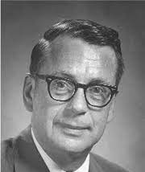
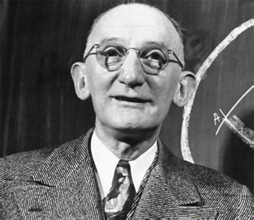
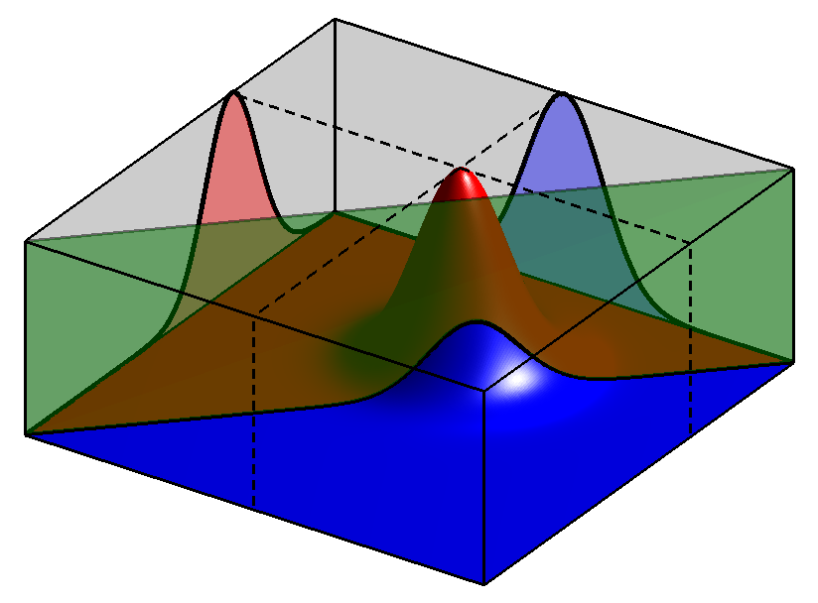
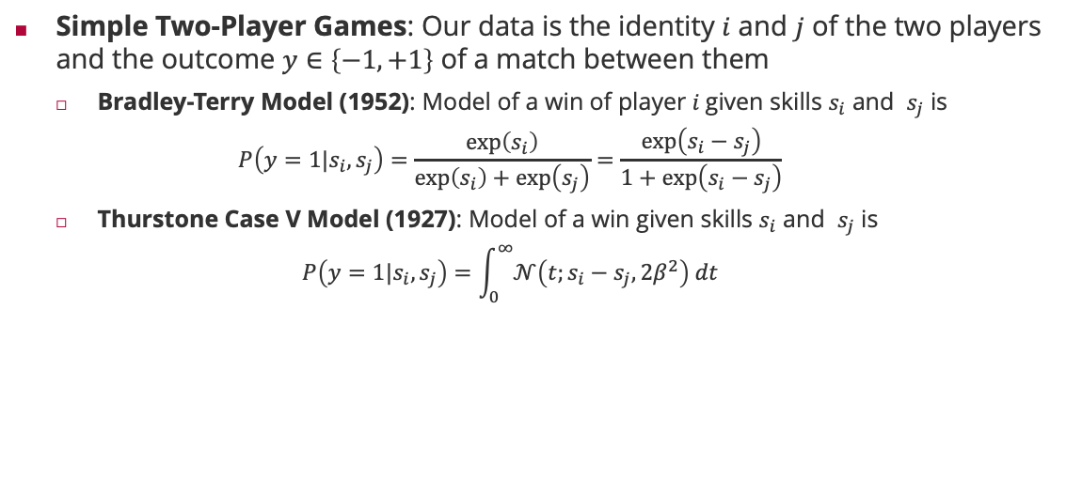
Two-Player Match Outcome Model
Simple Two-Player Games: Our data is the identity $i$ and $j$ of the two players and the outcome $y∈\left\{−1, +1\right\}$ of a match between them
Bradley-Terry Model (1952): Model of a win of player $i$given skills $s_{i}$ and $s_{j}$ is
$$P\left(y=1|s_{i},s_{j}\right)=\frac{\exp\left(s_{i}\right)}{\exp\left(s_{i}\right)+\exp\left(s_{j}\right)}=\frac{\exp\left(s_{i}−s_{j}\right)}{1+\exp\left(s_{i}−s_{j}\right)}$$
Thurstone Case V Model (1927): Model of a win given skills $s_{i}$ and $s_{j}$ is
$$P\left(y=1|s_{i},s_{j}\right)=\int_{0}^{∞}{𝒩\left(t;s_{i}−s_{j},2β^{2}\right) dt}$$
Logistic sigmoid in skill difference
Ralph A. Bradley (1923 – 2001)
Probit sigmoid in skill difference
Louis Leon Thurstone (1887 – 1955)
$$s_{1}$$
$$s_{2}$$
$$𝒩\left(p_{1};s_{1},β^{2}\right)$$
$$p_{1}$$
$$p_{2}$$
$$𝒩\left(p_{2};s_{2},β^{2}\right)$$
$$0$$
$$p_{2}$$
$$y$$
$$p_{1}$$
$$𝕀\left(y⋅\left(p_{1}−p_{2}\right)>0\right)$$

Slide 20
Two-Team Match Outcome Model
Team Assumption: Performance of a team is the sum of the performances of its players
Pro: Games where the team scores are additive (e.g., kill count in first-person shooter)
Con: Games where the outcome is determined by a single player (e.g., fastest car in a race)
Observation: Match outcomes correlate the skills of players
Same Team: Anti-correlated
Opposite Teams: Correlated
$$s_{1}$$
$$s_{2}$$
$$s_{3}$$
$$s_{4}$$
$$𝒩\left(t_{1};s_{1}+s_{2},{2β}^{2}\right)$$
$$t_{1}$$
$$t_{2}$$
$$𝒩\left(t_{2};s_{3}+s_{4},2β^{2}\right)$$
$$y$$
$$𝕀\left(y⋅\left(t_{1}−t_{2}\right)>0\right)$$

Slide 21


From Match Outcomes to Pairwise Rankings
Learning: In the ranking setting, we observe multi-team match outcomes and want to infer the skills of all single players!
Idea: Leverage the transitivity of the real line of latent scores!
$$s_{1}$$
$$s_{2}$$
$$s_{3}$$
$$s_{4}$$
$$𝒩\left(t_{1};s_{1},β^{2}\right)$$
$$t_{1}$$
$$𝒩\left(t_{2};s_{2}+s_{3},{2β}^{2}\right)$$
$$t_{2}$$
$$t_{3}$$
$$𝒩\left(t_{3}; s_{4},β^{2}\right)$$
$$y_{1,2}$$
$$y_{2,3}$$
$$𝕀\left(y_{1,2}=+1\right)$$
$$𝕀\left(y_{2,3}=+1\right)$$
By transitivity, this implies $t_{1}>t_{3}$

Slide 22
Overview
Probabilistic Machine Learning
The Sum-Product Algorithm
Ranking Problems
TrueSkill

Slide 23


























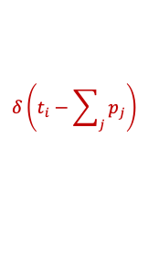
TrueSkill Factor Graphs
Bayesian Network
Factor Graph
$$s_{1}$$
$$s_{2}$$
$$s_{3}$$
$$s_{4}$$
$$𝒩\left(s_{i};μ_{i},σ_{i}^{2}\right)$$
$$t_{1}$$
$$t_{2}$$
$$t_{3}$$
$$s_{1}$$
$$s_{2}$$
$$s_{3}$$
$$s_{4}$$
$$𝒩\left(p_{i};s_{i},β^{2}\right)$$
$$y_{1,2}$$
$$y_{2,3}$$
$$p_{1}$$
$$p_{2}$$
$$p_{3}$$
$$p_{4}$$
$$δ\left(t_{i}−\sum_{j}{p_{j}}\right)$$
$$t_{1}$$
$$t_{2}$$
$$t_{3}$$
$$δ\left(d_{i,j}−\left(t_{i}−t_{j}\right)\right)$$
$$d_{1,2}$$
$$d_{2,3}$$
$$𝕀\left(d_{i,j}>0\right)$$

Slide 24






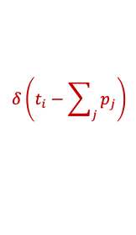











(Approximate) Message Passing in TrueSkill Factor Graphs
TrueSkill Factor Graph
Four Phases
Pass prior messages (1)
Pass messages down to the team performances (2 to 3)
Iterate the approximate messages on the pairwise team differences (4 to 9)
Pass messages back from up from team performances to player skill (10 – 12)
Since this is a tree, the algorithm is guaranteed to converge!
$$𝒩\left(s_{i};μ_{i},σ_{i}^{2}\right)$$
1
1
1
1
$$s_{1}$$
$$s_{2}$$
$$s_{3}$$
$$s_{4}$$
12
12
12
12
$$𝒩\left(p_{i};s_{i},β^{2}\right)$$
2
2
2
2
$$p_{1}$$
$$p_{2}$$
$$p_{3}$$
$$p_{4}$$
11
11
$$δ\left(t_{i}−\sum_{j}{p_{j}}\right)$$
11
11
3
3
3
$$t_{1}$$
$$t_{2}$$
$$t_{3}$$
$$δ\left(d_{i,j}−\left(t_{i}−t_{j}\right)\right)$$
10
6
9
10
4
7
$$d_{1,2}$$
$$d_{2,3}$$
5
8
$$𝕀\left(d_{i,j}>0\right)$$

Slide 25

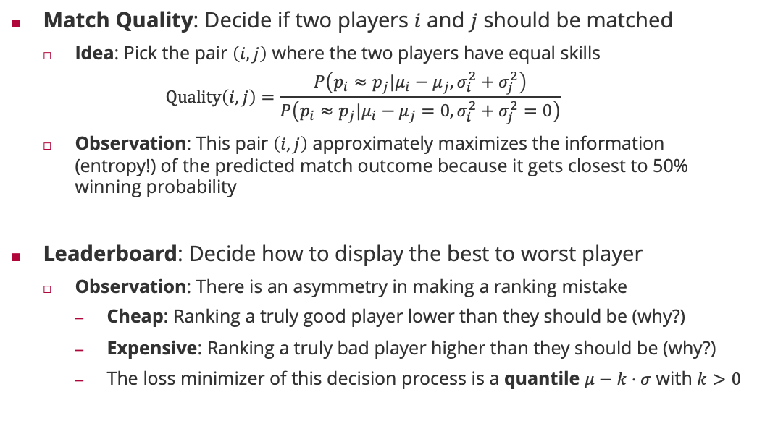
Decision Making: Match Quality and Leaderboards
Match Quality: Decide if two players $i$ and $j$ should be matched
Idea: Pick the pair $\left(i,j\right)$ where the two players have equal skills
$$Quality\left(i,j\right)=\frac{P\left(p_{i}≈p_{j}|μ_{i}−μ_{j},σ_{i}^{2}+σ_{j}^{2}\right)}{P\left(p_{i}≈p_{j}|μ_{i}−μ_{j}=0,σ_{i}^{2}+σ_{j}^{2}=0\right)}$$
Observation: This pair $\left(i,j\right)$ approximately maximizes the information (entropy!) of the predicted match outcome because it gets closest to 50% winning probability
Leaderboard: Decide how to display the best to worst player
Observation: There is an asymmetry in making a ranking mistake
Cheap: Ranking a truly good player lower than they should be (why?)
Expensive: Ranking a truly bad player higher than they should be (why?)
The loss minimizer of this decision process is a quantile $μ−k⋅σ$ with $k>0$

Slide 26

Experimental Results
40
Data Set: Halo 2 Beta
3 game modes
Free-for-All
Two Teams
1 vs. 1
> 60,000 match outcomes
≈ 6,000 players
6 weeks of game play
Publically available
35
30
25
Level
20
15
char (TrueSkill™)
10
SQLWildman (TrueSkill™)
5
char (Halo 2 rank)
SQLWildman (Halo 2 rank)
0
0
100
200
300
400
Number of Games

Slide 27
TrueSkill-Through-Time: Chess Players
Garry Kasparov
3000
2800
Robert James Fischer
Anatoly Karpov
2600
Mikhail Botvinnik
History of Chess 3.5M match outcomes 20 million variables
40 million factors
2400
Paul Morphy
Skill estimate
Whilhelm Steinitz
2200
Boris V Spassky
2000
Emanuel Lasker
1800
Jose Raul Capablanca
1600
Adolf Anderssen
1400
1850
1858
1866
1875
1883
1891
1899
1907
1916
1924
1932
1940
1949
1957
1965
1973
1981
1990
1998
2006
Year

Slide 28
See you next week!

